Slide 1
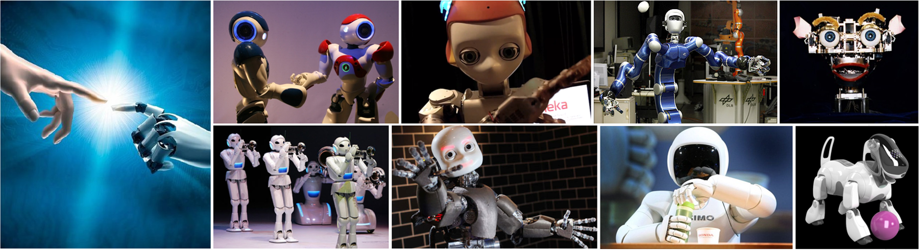
CMSC 591
Robotic Vision
Notes:
1

Slide 2
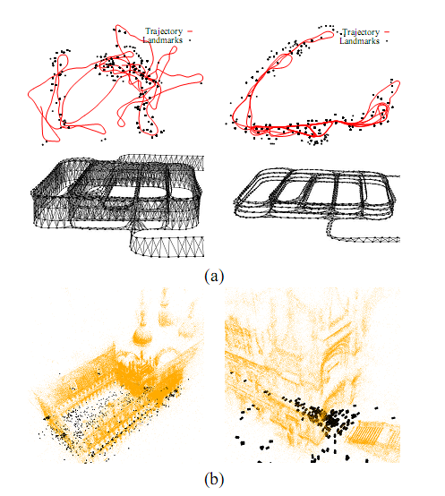
G2O Introduction
He Zhang (David)
Notes:
A general framework for graph optimization

Slide 3
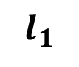
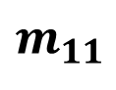
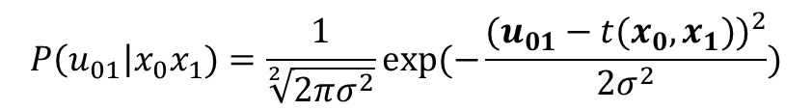
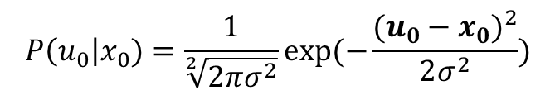
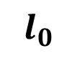
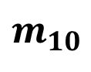
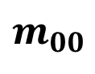
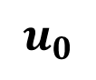
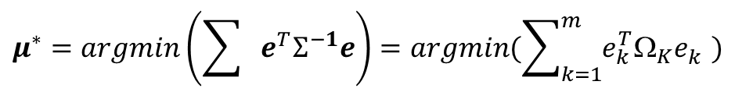
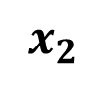
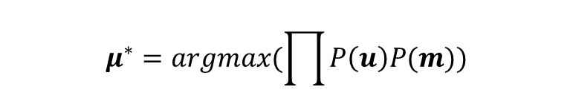
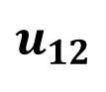
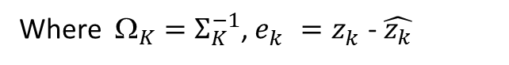
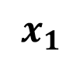
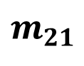
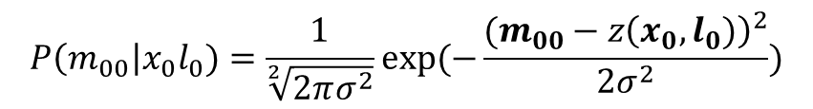
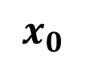
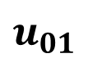
Graph SLAM Solution
For one-dimension case and assume Gaussian distribution model
$$\max{P\left(x_{0},x_{1},x_{2},l_{0},l_{1}\right|u_{0}u_{01}u_{12}m_{00}m_{10}m_{11}m_{21})}$$
$$P\left(u_{0}\right|x_{0})=\frac{1}{\sqrt[2]{2πσ^{2}}}exp⁡(−\frac{{(u_{0}−x_{0})}^{2}}{2σ^{2}})$$
$$u_{0}$$
$$x_{0}$$
$$x_{1}$$
$$x_{2}$$
$$u_{01}$$
$$u_{12}$$
$$P\left(u_{01}\right|x_{0}x_{1})=\frac{1}{\sqrt[2]{2πσ^{2}}}exp⁡(−\frac{{(u_{01}−t(x_{0},x_{1}))}^{2}}{2σ^{2}})$$
$$P\left(m_{00}\right|x_{0}l_{0})=\frac{1}{\sqrt[2]{2πσ^{2}}}exp⁡(−\frac{{(m_{00}−z\left(x_{0},l_{0})\right)}^{2}}{2σ^{2}})$$
$$m_{11}$$
$$m_{21}$$
$$m_{00}$$
$$m_{10}$$
…
$$μ^{∗}=argmax(\prod{P\left(u\right)P(m)})$$
$$l_{0}$$
$$l_{1}$$
$$μ^{∗}=argmin\left(\sum{e^{T}Σ^{−1}e}\right)=argmin(\sum_{k=1}^{m}{e_{k}^{T}Ω_{K}e_{k}^{}})$$
Where $_{K}=Σ_{K}^{−1}$, $e_{k}^{}=z_{k}^{}$- $\hat{z_{k}}$
True Measurement
Predicted Measurement
Notes:
What is a graph model? Let’s reuse previous example. Assume a robot moves from x0 to x2, and perceives two landmarks. Its graph structure is shown here. The red nodes stand for robot poses and the green for landmarks. The lines between them represent constraints: odometry constraints and landmark constraints. Each constraint represent a probability model. For example, assuming gaussian noise, p(u01) , now we want to estimate the value for variables x0 x1 x2 l0 and l1 that maximize the likelihood of the joint probability of this graph structure. By using log operation and remove the constant items, this maximize likelihood problem is converted into a nonlinear least square problem. The vector e incorporates residual error of each constraint, where sigma contains the corresponding measurement variance. Then it can be solved using an iterative nonlinear optimization method like gauss newton, gradient descendent or Levenberg–Marquardt algorithm. The linearized version can be represented by a matrix A and a vector b. A is called measurement jacobian and b include entries of the residual for each constraint. Later we will explain how they are constructed.

Slide 4
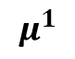
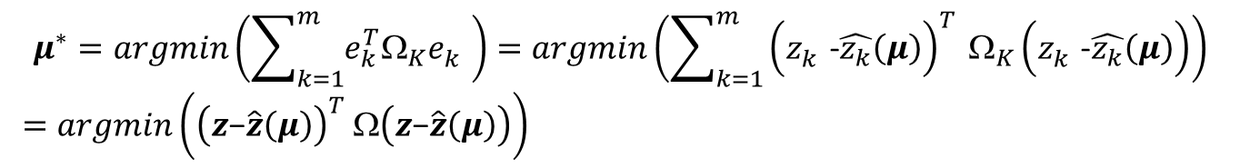
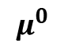
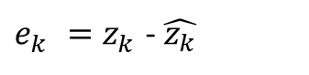
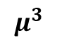
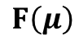
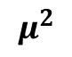
Nonlinear Least Square Optimization
$e_{k}^{}=z_{k}^{}$- $\hat{z_{k}}$
$$μ^{∗}=argmin\left(\sum_{k=1}^{m}{e_{k}^{T}Ω_{K}e_{k}^{}}\right)=argmin\left(\sum_{k=1}^{m}{{\left(z_{k}^{}\text{−}\hat{z_{k}}\left(μ\right)\right)}_{}^{T}Ω_{K}\left(z_{k}^{}\text{−}\hat{z_{k}}\left(μ\right)\right)}\right)$$
$=argmin\left({\left(z\text{−}\hat{z}\left(μ\right)\right)}_{}^{T}Ω\left(z\text{−}\hat{z}\left(μ\right)\right)\right)$
gradient
Parameter update
$$F\left(μ\right)$$
Gradient Descendent
$$μ^{0}$$
$$μ^{1}$$
$F\left(μ\right)=−2{\left(z\text{−}\hat{z}\left(μ\right)\right)}_{}^{T}Ω\left[\frac{∂\hat{z}\left(μ\right)}{∂μ}\right]=−2 {\left(z\text{−}\hat{z}\left(μ\right)\right)}_{}^{T}Ω J$
$$μ^{2}$$
$$μ^{k+1}=μ^{k}−α{(∇F\left(μ\right))}^{T}$$
$$μ^{3}$$
Learning rate
Notes:
mapping (SLAM) or bundle adjustment (BA) can be phrased as least squares optimization of an error function that can be represented by a graph.

Slide 5
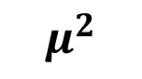
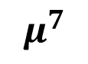
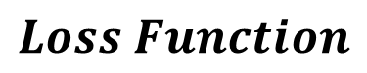
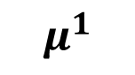
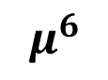
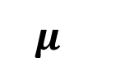
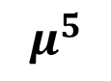
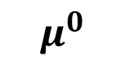
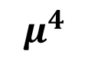
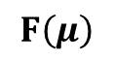
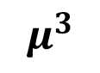
Gradient Descendent
$$μ^{k+1}=μ^{k}−α{(∇F\left(μ\right))}^{T}$$
Learning rate
$$Loss Function$$
$$F\left(μ\right)$$
$$μ^{}$$
$$μ^{0}$$
$$μ^{1}$$
$$μ^{2}$$
$$μ^{3}$$
$$μ^{6}$$
$$μ^{5}$$
$$μ^{4}$$
$$μ^{7}$$

Slide 6
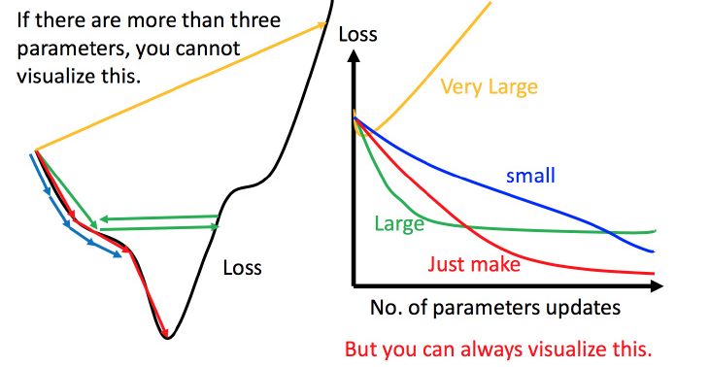
Learning rate
$$μ^{k+1}=μ^{k}−α{(∇F\left(μ\right))}^{T}$$
Learning rate
Gradient Descendent cannot find a proper solution if learning rate is too large,
or converges so slow if learning rate is too small

Slide 7
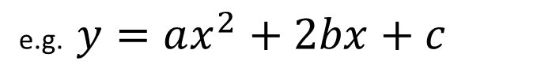
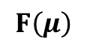
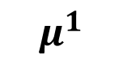
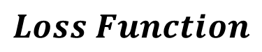

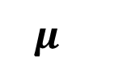
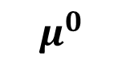
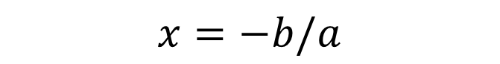
Gauss Newton
Locally quadratic polynomial
e.g. $y=ax^{2}+2bx+c$
$$x=−b/a$$
$$Loss Function$$
$$F\left(μ\right)$$
$$μ^{}$$
$$μ^{0}$$
$$μ^{1}$$
$$μ^{1}$$

Slide 8
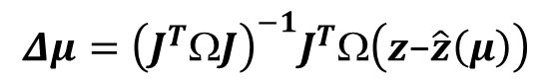
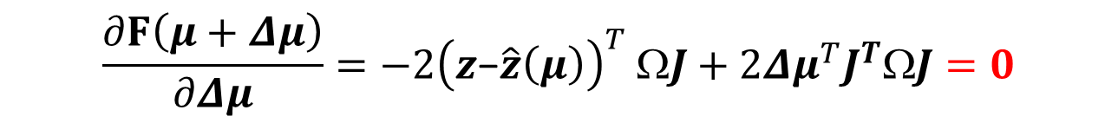
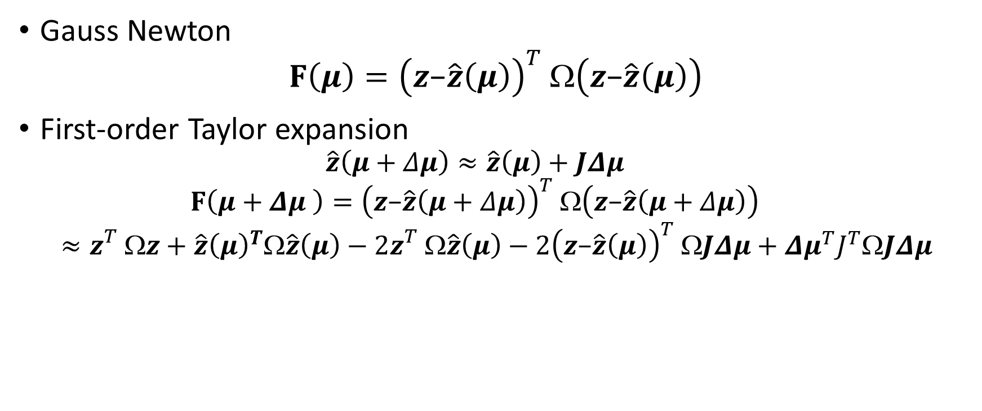
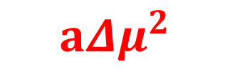




Nonlinear Least Square Optimization
Gauss Newton
$$F\left(μ\right)={\left(z\text{−}\hat{z}\left(μ\right)\right)}_{}^{T}Ω\left(z\text{−}\hat{z}\left(μ\right)\right)$$
First-order Taylor expansion
$$\hat{z}\left(μ+Δμ\right)≈\hat{z}\left(μ\right)+JΔμ$$
$$F\left(μ+Δμ \right)={\left(z\text{−}\hat{z}\left(μ+Δμ\right)\right)}_{}^{T}Ω\left(z\text{−}\hat{z}\left(μ+Δμ\right)\right)$$
$$≈z_{}^{T}z+{\hat{z}\left(μ\right)}^{T}\hat{z}\left(μ\right)−2z_{}^{T}\hat{z}\left(μ\right)−2{\left(z\text{−}\hat{z}\left(μ\right)\right)}_{}^{T}JΔμ+{Δμ}^{T}J^{T}JΔμ$$
$$x=−b/a$$
c
2b$Δμ$
$$a{Δμ}^{2}$$
$$\frac{∂F\left(μ+Δμ\right)}{∂Δμ}=−2{\left(z\text{−}\hat{z}\left(μ\right)\right)}_{}^{T}ΩJ+2{Δμ}^{T}J^{T}ΩJ=0$$
$$\left(J^{T}ΩJ\right) Δμ=J^{T}Ω\left(z\text{−}\hat{z}\left(μ\right)\right)$$
$$Δμ={\left(J^{T}ΩJ\right)}^{−1}J^{T}Ω\left(z\text{−}\hat{z}\left(μ\right)\right)$$
$a=$ $J^{T}J$
b=-${\left(z\text{−}\hat{z}\left(μ\right)\right)}_{}^{T}ΩJ$

Slide 9





Gauss Newton
$$x=−b/a$$
$$Loss Function$$
$$F\left(μ\right)$$
…
$$μ^{}$$
$$μ^{0}$$
$$μ^{5}$$
$$μ^{∗}$$
$$μ^{1}$$
$$μ^{2}$$
$$μ^{3}$$
$$μ^{4}$$

Slide 10









Gauss Newton
$$Loss Function$$
$$F\left(μ\right)$$
Too slow if the initial value $μ^{0}$ is far from the optimal $μ^{∗}$
。。。
$$μ^{0}$$
$$μ^{1}$$
$$μ^{2}$$
$$μ^{3}$$
$$μ^{∗}$$
$$μ^{}$$

Slide 11



















Levenberg Marquardt
$$\left(J^{T}ΩJ\right) Δμ=J^{T}Ω\left(z\text{−}\hat{z}\left(μ\right)\right)$$
damping parameter $λ$
$$Loss Function$$
$$\left(J^{T}ΩJ+λI\right) Δμ=J^{T}Ω\left(z\text{−}\hat{z}\left(μ\right)\right)$$
$$F\left(μ\right)$$
$$λ$$
$$Δμ$$
$$λ$$
$$Δμ$$
If ${F\left(μ\right)}^{k+1}<{F\left(μ\right)}^{k}$, decrease $λ$
If ${F\left(μ\right)}^{k+1}>{F\left(μ\right)}^{k}$, increase $λ$, redo k th iteration
$$λ$$
$$λ$$
$$λ$$
$$λ$$
$$μ^{0}$$
$$μ^{1}$$
$$μ^{2}$$
$$μ^{3}$$
$$μ^{4}$$
$$μ^{4}$$

Slide 12















Summary
$$μ^{0}$$
$$μ^{∗}=argmin\left({\left(z\text{−}\hat{z}\left(μ\right)\right)}_{}^{T}Ω\left(z\text{−}\hat{z}\left(μ\right)\right)\right)$$
$$μ^{1}$$
Machine Learning
$$μ^{2}$$
$$F\left(μ\right)$$
Gradient Descendent (GD)
Steepest direction
Gauss Newton (GN)
Locally quadratic fitting
Levenberg Marquardt (LM)
Damping parameter
Dogleg
Trust region
$$μ^{k+1}=μ^{k}−α{(∇F\left(μ\right))}^{T}$$
$$μ^{3}$$
$$Δμ={\left(J^{T}ΩJ\right)}^{−1}J^{T}Ω\left(z\text{−}\hat{z}\left(μ\right)\right)$$
$μ^{k+1}=μ^{k}$+ $Δμ$
$$Δμ={\left(J^{T}ΩJ+λI\right)}^{−1}J^{T}Ω\left(z\text{−}\hat{z}\left(μ\right)\right)$$
$$x=−b/a$$
$μ^{k+1}=μ^{k}$+ $Δμ$
$$Δμ={\left(J^{T}ΩJ+λI\right)}^{−1}J^{T}Ω\left(z\text{−}\hat{z}\left(μ\right)\right)$$
$μ^{k+1}=μ^{k}$+ min($Δμ,∆^{k}$)
Robotics Community
$$\left\|Δμ\right\|<∆^{k}$$

Slide 13


Why machine learning/ deep learning does not use GN/LM/Dogleg?
GN/LM/Dogleg cost more computational time than GD
Efficiency: too much computational burden if use GN/LM/Dogleg, since too many parameters ~${10}^{7}$

Slide 14


What if number of nodes in SLAM grows to ${10}^{7}$, efficiency issue?
Wang, Rui, Martin Schworer, and Daniel Cremers. "Stereo DSO: Large-scale direct sparse visual odometry with stereo cameras." Proceedings of the IEEE International Conference on Computer Vision. 2017.

Slide 15









What if number of nodes in SLAM grows to ${10}^{7}$, efficiency issue?
No
Update Check
Submapping (Divide and Conquer)
…
$$1$$
$$2$$
$$3$$
$${10}^{7}$$
…
…
…
$$1$$
$$2$$
$$3$$
$${10}^{7}$$

Slide 16


Robotics Community
SLAM
Machine Learning
Deep learning
Gauss Newton (GN)
Locally quadratic fitting
Levenberg Marquardt (LM)
Damping parameter
Dogleg
Trust region
Gradient Descendent (GD)
Steepest direction

Slide 17
Graph SLAM Solution
For one-dimension case and assume Gaussian distribution model
$$\max{P\left(x_{0},x_{1},x_{2},l_{0},l_{1}\right|u_{0}u_{01}u_{12}m_{00}m_{10}m_{11}m_{21})}$$
$$P\left(u_{0}\right|x_{0})=\frac{1}{\sqrt[2]{2πσ^{2}}}exp⁡(−\frac{{(u_{0}−x_{0})}^{2}}{2σ^{2}})$$
$$u_{0}$$
$$x_{0}$$
$$x_{1}$$
$$x_{2}$$
$$u_{01}$$
$$u_{12}$$
$$P\left(u_{01}\right|x_{0}x_{1})=\frac{1}{\sqrt[2]{2πσ^{2}}}exp⁡(−\frac{{(u_{01}−t(x_{0},x_{1}))}^{2}}{2σ^{2}})$$
$$P\left(m_{00}\right|x_{0}l_{0})=\frac{1}{\sqrt[2]{2πσ^{2}}}exp⁡(−\frac{{(m_{00}−z\left(x_{0},l_{0})\right)}^{2}}{2σ^{2}})$$
$$m_{11}$$
$$m_{21}$$
$$m_{00}$$
$$m_{10}$$
…
$$μ^{∗}=argmax(\prod{P\left(u\right)P(m)})$$
$$l_{0}$$
$$l_{1}$$
$$μ^{∗}=argmin\left(\sum{e^{T}Σ^{−1}e}\right)=argmin(\sum_{k=1}^{m}{e_{k}^{T}Ω_{K}e_{k}^{}})$$
Where $_{K}=Σ_{K}^{−1}$, $e_{k}^{}=z_{k}^{}$- $\hat{z_{k}}$
True Measurement
Predicted Measurement
Notes:
What is a graph model? Let’s reuse previous example. Assume a robot moves from x0 to x2, and perceives two landmarks. Its graph structure is shown here. The red nodes stand for robot poses and the green for landmarks. The lines between them represent constraints: odometry constraints and landmark constraints. Each constraint represent a probability model. For example, assuming gaussian noise, p(u01) , now we want to estimate the value for variables x0 x1 x2 l0 and l1 that maximize the likelihood of the joint probability of this graph structure. By using log operation and remove the constant items, this maximize likelihood problem is converted into a nonlinear least square problem. The vector e incorporates residual error of each constraint, where sigma contains the corresponding measurement variance. Then it can be solved using an iterative nonlinear optimization method like gauss newton, gradient descendent or Levenberg–Marquardt algorithm. The linearized version can be represented by a matrix A and a vector b. A is called measurement jacobian and b include entries of the residual for each constraint. Later we will explain how they are constructed.

Slide 18















Graph Model in G2O
$$x_{0}$$
$$x_{1}$$
$$x_{2}$$
$$e_{01}$$
$$e_{12}$$
$$e_{14}$$
$$e_{24}$$
$$e_{03}$$
$$e_{13}$$
$$x_{3}$$
$$x_{4}$$
$$e_{ij}\left(x\right)=z_{ij}−{\hat{z}}_{ij}$$
Kümmerle, Rainer, et al. "g2o: A general framework for graph optimization." IEEE International Conference on Robotics and Automation., 2011
Notes:
In G2O, all the variables are generally treated as nodes, representing the parameters to be estimated. They are denoted as x. An edge is represented by the residual error of its constraint, which is denoted by e. Each constraint is modeled like this figure. The zij and Omega represent the mean and information matrix of a constraint relating to the parameters xi and xj. Z hat ij, represents the estimator for the mean value of this measurement constraint. This constraint could be a odometry measurement, or a landmark measurement.
The difference between the estimator z hat ij and the true mean value is called the residual error.

Slide 19








G2O
$$x_{0}$$
$$x_{1}$$
$$x_{2}$$
$$e_{01}$$
$$e_{12}$$
Taylor expansion
$$e_{14}$$
$$e_{24}$$
$$e_{03}$$
$$e_{13}$$
$$x_{3}$$
$$x_{4}$$
Quadratic polynomial
$$x=−b/a$$
Sum up

Slide 20





G2O
$$x_{0}$$
$$x_{1}$$
$$x_{2}$$
$$e_{01}$$
$$e_{12}$$
$$e_{14}$$
$$e_{24}$$
$$e_{03}$$
$$e_{13}$$
$$x_{3}$$
$$x_{4}$$
$$x=−b/a$$
Iteration
or

Slide 21


G2O Framework
Kümmerle, Rainer, et al. "g2o: A general framework for graph optimization." IEEE International Conference on Robotics and Automation., 2011
Notes:
This is a overview about the G2O framework. From the beginning, the error function of the edge constraints need to be defined. Also, the nonlinear add operator needs to be defined. Next, the jacobian, In G2O, in default, it provides numeric jacobian, so its optional to write your own jacobian. If you do that, it will reduce computation cost and increase speed. In g2o, it use Levenberg Marquardt algorithm. The linear solver and the linear structure are provided. You can choose one of them.
So, to address a new optimization problem, only the boxes in blue rectangle need to specified. If your parameters are in the Euclidean space, you even do not need to specify the nonlinear add operator.
The jacobian is optional. For the others, you can choose by setting certain parameters, which I will show you later. So, you can notice that G2O is very easy to use. You need to understand your problem and defines the error functions of your variables in different constraints.

Slide 22



Update Operator
Euclidean Space
Non Euclidean Space parameters
unit vector $\overline{n}=[n_{x},n_{y},n_{z}]$, DoF (2), span SO(2)
quaternion $\overline{q}=[q_{x},q_{y},q_{z},q_{w}]$, DoF (3), span SO(3)
lie algebra
Notes:
The procedures described above are general approaches to multivariate function minimization. They assume that the space of parameters x is Euclidean. This assumption is not valid for SLAM problems.
Parameters that span non-Euclidean space, they cannot be simply added together. For example, the normal vector of a plane, it has three components, while its degree of freedom is only two since its normal is constraint to be 1. It spans the non-Euclidean 2D or 3D rotation group SO(2).
# Other examples are homographic representation of a image point, and also quaternions, etc.
Such Cases usually have more components than their actual degree of freedom, directly adding them into graph to optimize will cause the over-parameterization problem. It means you have redundant parameters in your model. For a overparameterized system, the information matrix will be singular, and any attempt to invert it within gauss-newton will fail. Although, Levenberg-Marquardt can mitigate this issue by adding a regularization term, this could negative affect its converge speed.
So, a better and more decent solution is minimal parameterization. The core idea is that, the increment/perturbation dx is not computed in their own space, instead, dx is computed in their tangent space. Let’s take the normal vector for example.
Let’s see this figure,

Slide 23
Materials
https://github.com/rising-turtle/slam_course
Kümmerle, Rainer, et al. "g2o: A general framework for graph optimization." IEEE International Conference on Robotics and Automation., 2011.
g2o manual
Joan Sol`, “Course on SLAM”, 2016
Förstner, Wolfgang. "Minimal representations for uncertainty and estimation in projective spaces." Asian Conference on Computer Vision. Springer, Berlin, Heidelberg, 2010.

Slide 24





SO(2)
$$\overline{n′}$$
$$∆x$$
$$∆x$$
$$\overline{n}$$

Slide 25



Minimal Parameterization
Nonlinear Operator
Notes:
To tackle this problem, in G2o, a nonlinear operator is defined to generalize the update for parameters over non-Euclidean space. For example, if x represents only translation, the operation is equal to plus. If x represents both translation and rotation, this operation equal to standard motion composition operator. So you need to define this operation in your own application.
But the math behind is to compute the jacobian of the cost function with respect to the increment dx in the tangent space of the variable.

Slide 26


Minimal Parameterization
Nonlinear Operator
Notes:
Given the nonlinear operator, the error term e() can be rewritten as this . Notice that here the jacobian Jij is different. Since it is computed in the tangent space of x, not in the space of x. So when dx is solved, it has to be mapped to the original space of x using this nonlinear operator again.
Optimization problem becomes

Slide 27







Structure of Linearized System
Gauss Newton
Levenberg Marquardt
$$μ=A^{−1}∗b$$
Notes:
Now let’s dive into the structure of the information matrix H and residual vector b.
the matrix H and the vector b are obtained by summing up a set of matrices and vectors
The structure of this addend depends on the Jacobian of the error function. Since the error function of a constraint depends only on the values of two nodes, the Jacobian.
Here Aij and Bij are the derivatives of the error function with respect to ∆xi and ∆xj.
Then we can obtain the following structure for the block matrix Hij, does it seem to be familiar to you, it is nothing magic. Last class we learn how to solve this graph problem? Just compute the information matrix A and the residual vector b, here it’s the same concept.
For simplicity of notation we omitted the zero blocks. You might notice that the block structure of the matrix H is the adjacency matrix of the graph. Thus, it has a number of non-zero blocks proportional to number of edges in the graph. This typically results in sparse H matrices. G2o take advantage of this characteristic of H by utilizing state-of-the-art approaches to solve the linear system this equation.

Slide 28
Kernel cost function

Slide 29


Application Example: G2O Based SLAM method for SmartCane Project
H. Zhang and C. Ye, "An Indoor Wayfinding System based on Geometric Features Aided Graph SLAM for the Visually Impaired," IEEE Transactions on Neural Systems and Rehabilitation Engineering, vol. 25, no. 9, pp. 1592-1604, 2017

Slide 30













Plane-Aided Graph SLAM
Floor plane in Graph Structure
Parameterization of Plane
$$Z$$
$$n_{k}^{}$$
$$O_{k}^{}$$
$$d_{k}^{}$$
$$O$$
$$β_{k}^{}$$
$$Y$$
$$α_{k}^{}$$
$$X$$
$n_{k}^{}$ is the normal vector of plane K
A graph with 5 P-nodes and 1 FP-node for
PAG-SLAM (Plane Aided Graph SLAM)
$$e_{ik}^{f}=z_{ik}^{f}−{\hat{z}}_{ik}^{f}=\left[\begin{matrix}α_{k}^{i} \\ \begin{aligned}β_{k}^{i} \\ d_{k}^{i}\end{aligned}\end{matrix}\right]−\left[\begin{aligned}\begin{matrix}{\hat{α}}_{k}^{i} \\ {\hat{β}}_{k}^{i}\end{matrix} \\ {\hat{d}}_{k}^{i}\end{aligned}\right]$$
Edge between P-nodes computed from VRO
Edge between P-node and FP-node computed from plane model defined in the right
$$C_{π_{k}^{i}}=F_{q}\left(\begin{matrix}Σ_{q_{1}} & ⋯ & 0 \\ ⋮ & ⋱ & ⋮ \\ 0 & ⋯ & Σ_{q_{m}}\end{matrix}\right)F_{q}^{T}$$
Add Floor Plane to reduce pitch, roll, and z pose errors
Notes:
The parameters of a plane involve a normal vector, and a distance between the original point to the plane. The error for the plane measurement is given by the difference between the plane’s normal vector and distance. The covariance of the plane measurement is estimated using the standard error propagation function.
The right figure shows an example with 5 pose nodes and 1 Floor plane node. By adding the floor plane into the graph structure, we can reduce roll, pitch and z errors through graph optimization.
Another alternative representation uses the azimuth and elevation angles to represent the surface normal direction. We choose the angular representation because it has the true dof with regards to a plane.

Slide 31




Line-Aided Graph SLAM
Lines in Graph Structure
Parameterization of Line in 2D floor-plan
A graph with 5 P-nodes and 3 L-nodes for LAG-SLAM (Line Aided Graph SLAM)
$$e_{ik}^{l}=z_{ik}^{l}−{\hat{z}}_{ik}^{l}=\left[\begin{matrix}α_{ik}−α_{k}+φ \\ d_{ik}+x\cos{α_{k}}+y\sin{α_{k}}−d_{k}\end{matrix}\right]$$
Edge between P-nodes computed from VRO
Edge between P-node and L-node computed from line model defined in the right
$$C_{l_{k}^{i}}=F_{pt′}\left(\begin{matrix}Σ_{{pt}_{1}}^{l′} & ⋯ & 0 \\ ⋮ & ⋱ & ⋮ \\ 0 & ⋯ & Σ_{{pt}_{m}}^{l′}\end{matrix}\right)F_{pt′}^{T}$$
Add Wall lines to reduce yaw, x and y errors
Notes:
The parameters of a line involve an angle alpha, between the line normal direction and the X axis, and a distance between the original point and the line. The error and covariance of the line measurement is then computed. The right figure shows an example with 5 pose nodes and 3 line nodes.
By adding the wall lines of the floor plan into the graph structure, we can yaw and x y errors.

Slide 32

Task: Swing Smartcane from copy room to room 555
H. Zhang and C. Ye, "An Indoor Wayfinding System based on Geometric Features Aided Graph SLAM for the Visually Impaired," IEEE Transactions on Neural Systems and Rehabilitation Engineering, vol. 25, no. 9, pp. 1592-1604, 2017

Slide 33
demo

Slide 34




Bundle Adjustment
Schur complement
Robot pose
$$S_{PP}$$
Landmark positions

